Slide 1

Smart Bite
PRESENTED BY:
Mahmoud Samer 231006523
Rawan Atef 231005789
Rokaya Hamdy 231006586
Retaj Ali 231005689
Youssef Karim 231014449
Youssef Mahmoud 231006058

Slide 2

Table of contents
01
02
03
04
05
06
Introduction
Project Charter
Scope
Microsoft Project
07
Cost Estimation
Quality Management
Risk Management

Slide 3

01
Introduction

Slide 4

Introduction
Smart Bite is an AI-driven recipe maker created to transform ordinary kitchen ingredients into practical, healthy meals. By combining a camera-based ingredient scanner with an intelligent recipe engine, it solves the everyday question: “What should I cook?”, Instead of guiding users on what to buy or offering professional dietary plans, Smart Bite focuses on a clear purpose of connecting the ingredients people already have to meals they can make.
This app is designed for students, busy professionals, families, and anyone short on time or cooking experience, Smart Bite reduces food waste, saves money, encourages healthier eating habits and simplifies decision-making by instantly turning available items into cost-effective, nutritious recipes

Slide 5
02
Project Charter

Slide 6
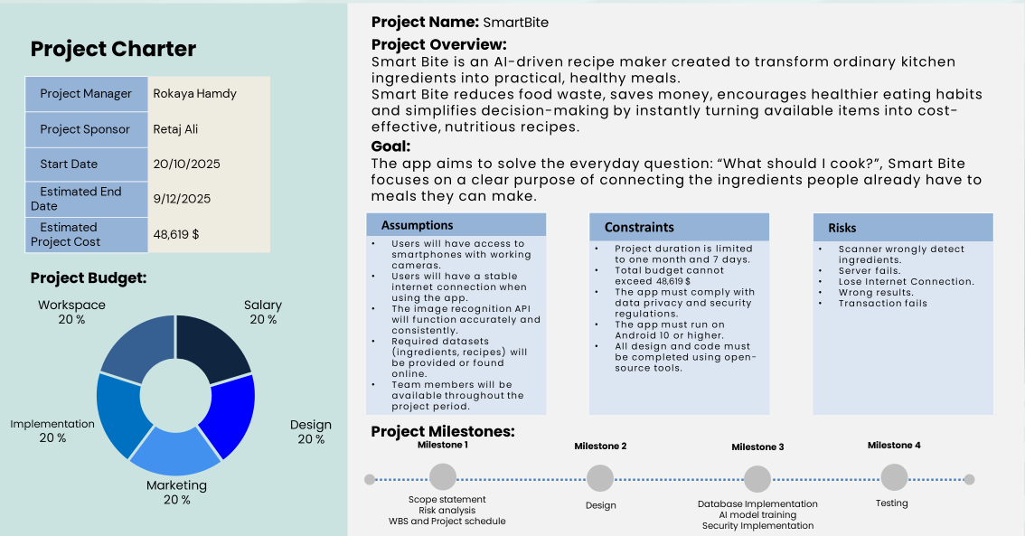

Slide 7
03
Scope

Slide 8
Scope
Smart Bite is not designed to replace the grocery store, meal delivery services or professional nutrition counselling. Instead, its role is focused & clear: to help users make the most of what they already have at home. The product directly addresses common problems like wasted groceries, limited cooking skills and lack of time to plan meals.
The project is limited to converting the user’s existing ingredients into ready-to-cook recipes. It does not include external integrations such as online stores or health tracking services. These boundaries ensure that Smart Bite stays focused on its core purpose; bridging the gap between a cluttered fridge and a finished dish — while preventing scope creep

Slide 9
04
Microsoft Project

Slide 10
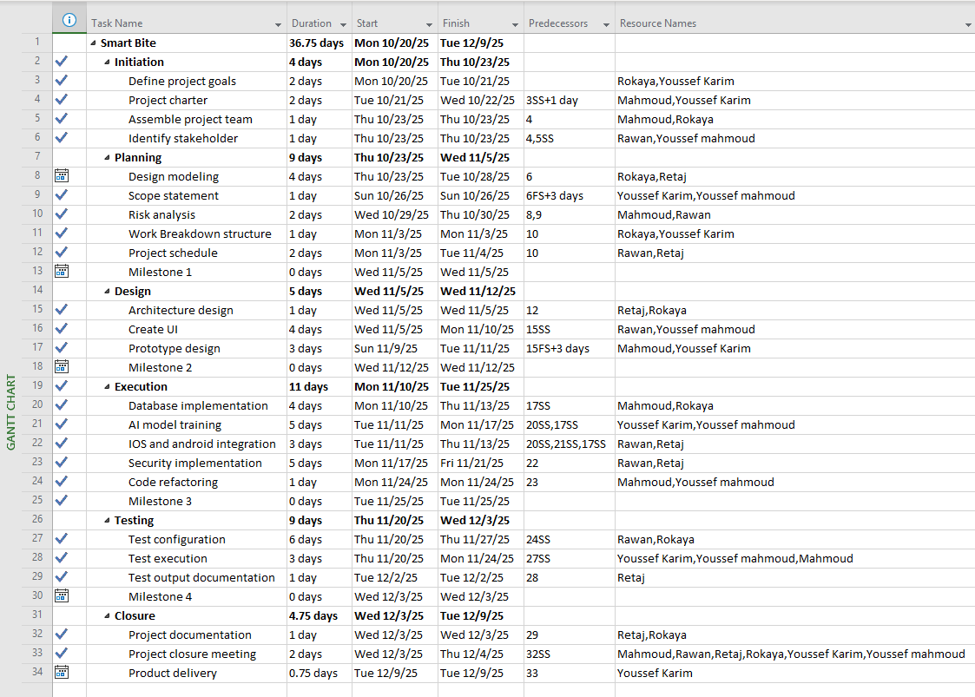
Work Breakdown Structure

Slide 11
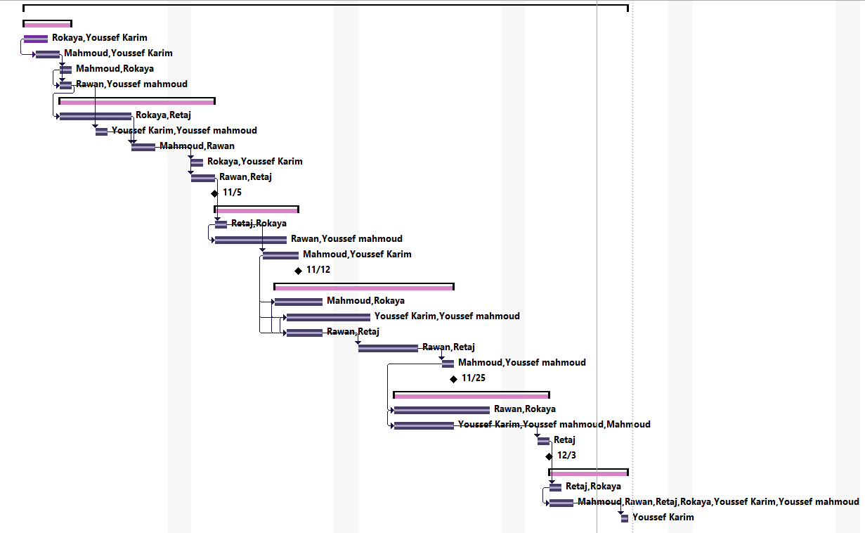
Gantt Chart

Slide 12
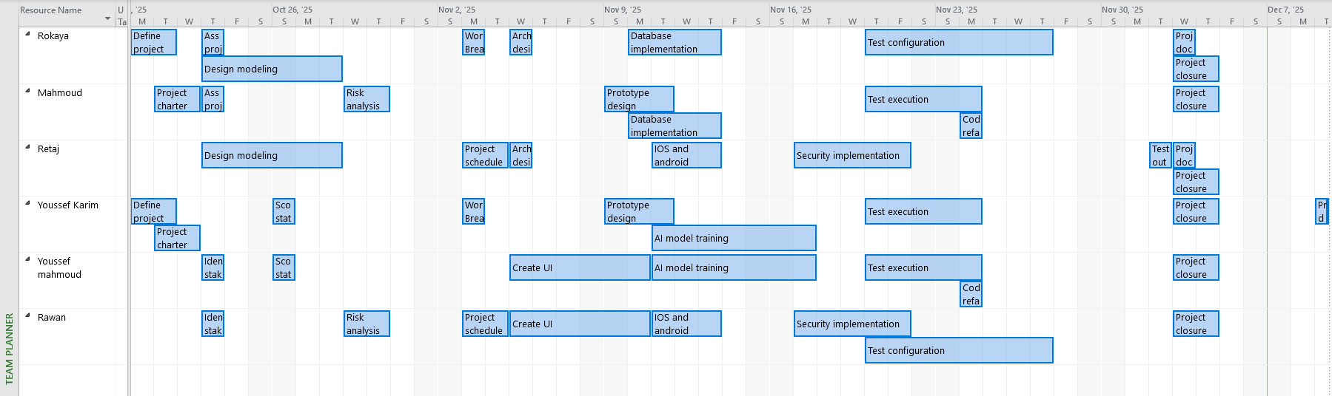
Team Planner

Slide 13
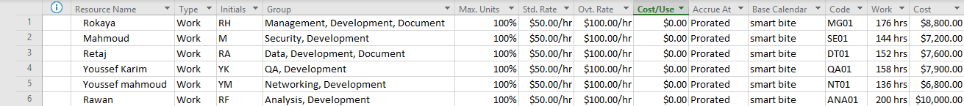
Resource Sheet

Slide 14
05
Cost Estimation

Slide 15
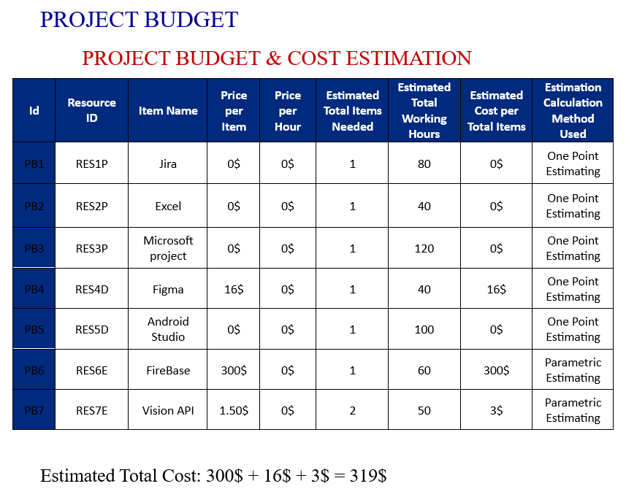

Slide 16
06
Quality Management

Slide 17
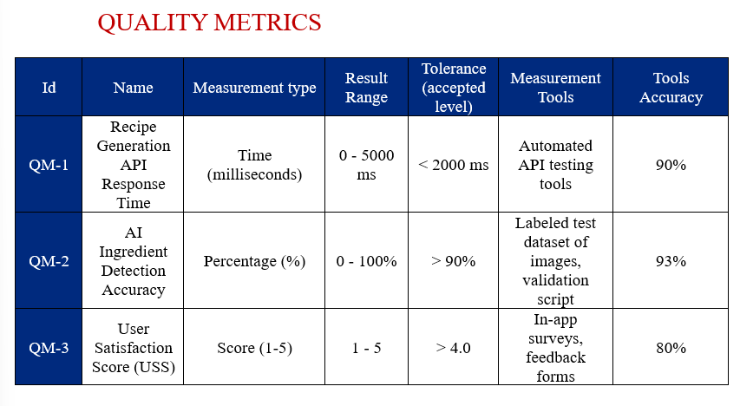

Slide 18
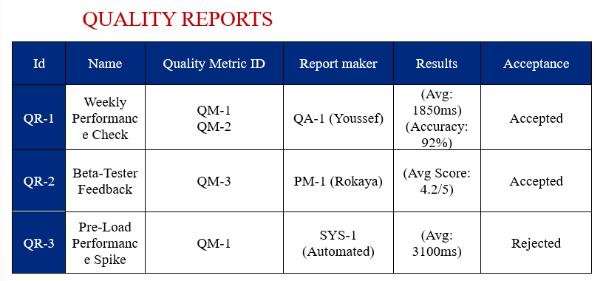

Slide 19
07
Risk Management

Slide 20
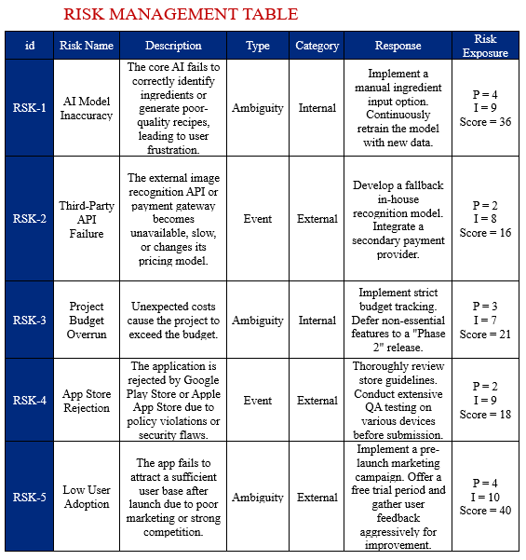

Slide 21
Thanks

